Slide 1

15th CAA Cross-Calibration Workshop /17-19 April 2012
University College of London
STAFF Report

Slide 2
STAFF Report
Status of data delivery
Delivery Plan
Status of data pipeline
STAFF/FGM cross calibration
Conclusions

Slide 3
1. Status of data delivery:
a. STAFF-SA
Product | Content | Level | Num. of files | Produced | Delivered to CAA
C?_CP_STA_AGC | Automatic Gain Control | 1 | 1 file/ 1 sat./24h | V04: 01/01/2001 to 31/12/2010 V05: 01/01/2011 to 31/12/2011 | V04: 01/01/2001 to 31/12/2010 V05: 01/01/2011 to 31/12/2011
C?_CP_STA_PSD | Power Spectral Density | 2 | 1 file/ 1 sat./24h | V04: 01/01/2001 to 31/12/2010 V05: 01/01/2011 to 31/12/2011 | V04: 01/01/2001 to 31/12/2010 V05: 01/01/2011 to 31/12/2011
C?_CP_STA_SM | Spectral Matrix | 2 | 1 file/ 1 sat./24h | V04: 01/01/2001 to 31/12/2010 V05: 01/01/2011 to 31/12/2011 | V04: 01/01/2001 to 31/12/2010 V05: 01/01/2011 to 31/12/2011

Slide 4
1. Status of data delivery:
a. STAFF-SA
Product | Content | Level | Num. of files | Produced | Delivered to CAA
C?_CQ_STA_SA_ NOT SRP_ CAVEATS | PSD/SM Caveat | 2 | 1 file/ 1 sat./24h | V01: 01/01/2001 to 31 Sep 2011 | V01: 01/01/2001 to 31/12/2011
C?_CQ_STA_SA_ PSD NEG_ CAVEATS | SM Caveat | 2 | 1 file/ 1 sat./24h | V01: 01/01/2001 to 31 Sep 2011 | V01: 01/01/2001 to 31/12/2011
C?_CP_STA_PPP | Polarisation and Propagation Parameters | 3 | 1 file/ 1 sat./24h | V04: 01/01/2001 to 31/12/2009 | V04: 01/01/2001 to 31/12/2009
C?_CQ_STA_SA_ UNDEFINED_MFA _ CAVEATS | PPP Caveat | 3 | 1 file/ 1 sat./24h | V01: 01/01/2001 to 31/12/2009 | V01: 01/01/2001 to 31/12/2009

Slide 5
1. Status of data delivery:
b. STAFF-SC: NBR and HBR mode
Product | Content | Level | Num. of files | Produced | Delivered to CAA
C?_CP_STA_DWF | Decommutated Waveform | 1 | 1 file/mode/ 1 sat./24h | V02: 01/01/2001 to 31/12/2006 V03: 01/01/2007 to 31/12/ 2009 V04: 01/01/2010 To 31/12/2011 | V02: 01/01/2001 to 31/12/2006 V03: 01 Jan. 2007 to 31 Dec. 2009
C?_CP_STA_CWF | Calibrated waveform | 2 | 1 file/mode/ 1 sat./24h | Few test files | None
C?_CP_STA_CS | Calibrated Spectra | 2 | 1 file/mode/ 1 sat./24h | V02: 01/01/2001 to 31/12/2005 V03: 01/01/2006 to 31/12/2010 | V02: 01/01/2001 to 31/12/2005 V03: 01/01/2006 to 31/12/2009
CL_CG_STA_SC_ SPECTRO | Spectrograms Plots | 3 | 1 file/ 4 sat./3h | V01: 01/01/2001 to 31/12/2011 | V01: 01/01/2001 to 31/12/2011

Slide 6
2. Delivery plan:
Year of delivery Product | 2012 | 2013
SC DWF Version 4 | 2010-2011 2001-2009 | 2012
SC Complex spectra V 4 | 2010-2011 2001-2009 | 2012
SC Images | 2012
SC CWF New | 2001-2006 | 2007-2012
SA AGC/ PSD / SM/ Version 4 | - | 2012
SA AGC/ PSD / SM/ BE products = Version 5 | 2011 2001-2005 | 2006-2010 2012
SA Polarisation/ Propagation | 2010-2011 | 2012

Slide 7
3. Status of data pipeline:
SA:
  Data pipelines are operational.
SC:
  DWF pipeline was rebuild in order to add new elements needed by CWF data.
  CS pipeline need to be updated according to new calibration tables.
  → All these data will be reproduced and delivered to CAA for the complete mission period.
  CWF pipeline is close to be completed. It is ready for ISR2 but it needs a patch to produce in the same time data in ISR2 and in GSE. This pipeline was delayed due to the comparison between FGM and STAFF, in order to validate the new calibration process.

Slide 8
Validation tool
SpectroCWF.ps
(XYZ)
VTL2.rff
CWF.cef
=~76h30
Validation tool
~15 h for NBR
~60 h for HBR
~2 min for NBR
~3 min for HBR
WFL1.rff
VTL1.rff
~2 min for NBR
~3 min for HBR
DWF.cef
=~1h30
~30 min for NBR
~50 min for HBR
~20 min for NBR
~50 min for HBR
CSL2.rff
CS.cef
=~2h45
Time given for one month for 4 satellites with one CPU.
~2 min for NBR
~3 min for HBR

Slide 9
4. STAFF-FGM Cross-Calibration:
a. The old calibration
• Fit of Bx and By components in spinning system by a sine signal at spin frequency give estimate of Bperp amplitude and phase angle φ.
• Amplitude assumed to be constant during the window sampling.
20 sec
• B_{DC} sample rate must be > 1 spin period.
b. The new calibration
• Sliding windows, giving continuous estimate of B_{DC} and B_{waves}
• Final CWF are the sum of B_{DC} and B_{waves}
• Initial sample rate preserved.
40 sec

Slide 10
4. STAFF-FGM Cross-Calibration:
b. The new calibration
Problem with the original ground calibration of the instruments, due to non circular Helmoltz coils (time degradation).
→ New measurements done in Chambon-la-forêt by the technical team with new Helmoltz coils lead to new calibration tables and new transfer functions.

Slide 11
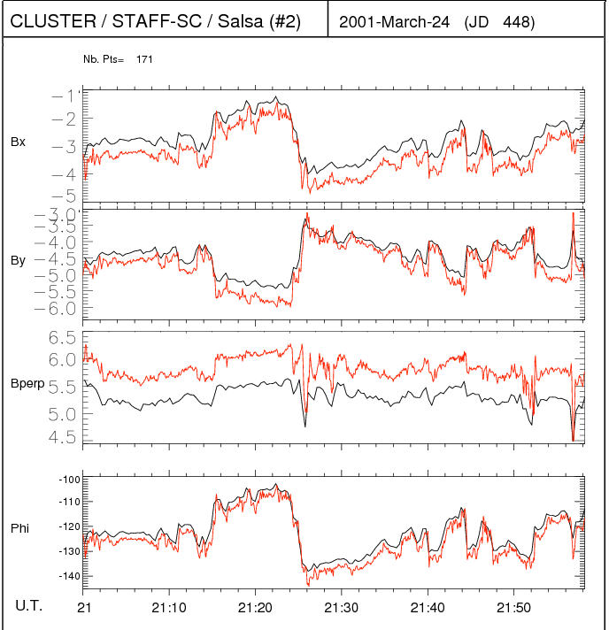
4. STAFF-FGM Cross-Calibration:
b. One event comparison
SR2
FGM: PPD 4s / STAFF Despin Software 20s
<∆B⊥/B⊥> ± σB⊥/B⊥
≃ 10%±2%

Slide 12
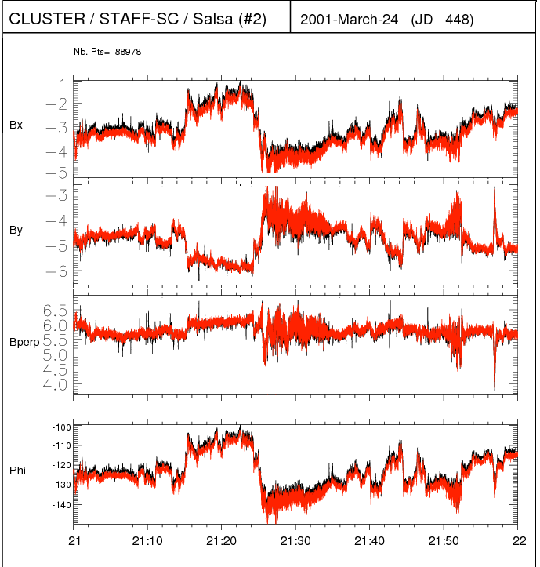
4. STAFF-FGM Cross-Calibration:
b. One event comparison
SR2
SR2
FGM: PPD 4s / STAFF: Despin Software 20s
<∆B⊥/B⊥> ± σB⊥/B⊥
≃ 10%±2%
FGM: CAA FULL / STAFF: Cont. cal. method
<∆B⊥/B⊥>±σB⊥/B⊥
≃ 1%±1%

Slide 13
4. STAFF-FGM Cross-Calibration:
b. One event comparison
SR2
SR2
FGM: PPD 4s / STAFF: Despin Software 20s
<∆B⊥/B⊥> ± σB⊥/B⊥
≃ 10%±2%
FGM: CAA FULL / STAFF: Cont. cal. method
<∆B⊥/B⊥>±σB⊥/B⊥
≃ 1%±1%

Slide 14
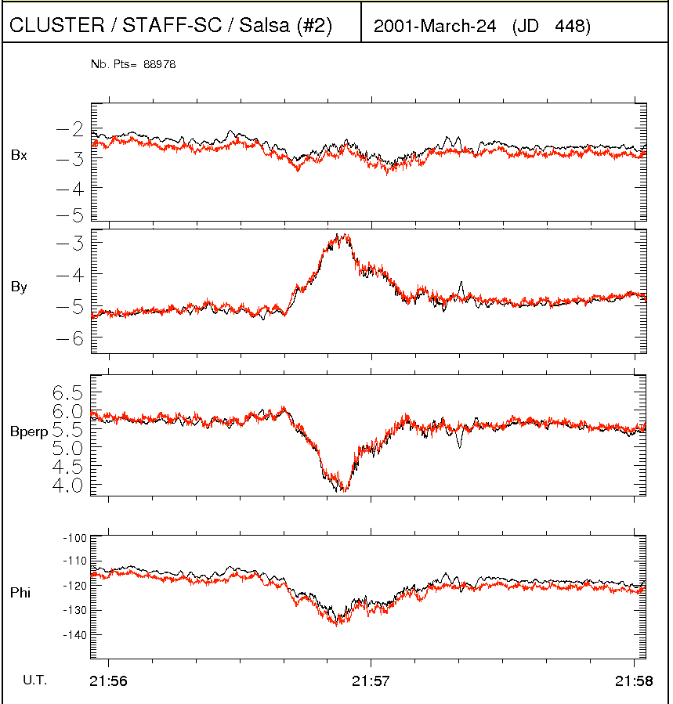
4. STAFF-FGM Cross-Calibration:
b. One event comparison
SR2
Continuous calibration works well even on short time scale.
∆B⊥/B⊥ < 1%
∆ϕ ≃3° → under study.

Slide 15
4. STAFF-FGM Cross-Calibration:
b. One event comparison
SR2
Spin residue
It could be removed in next update but it is still under discussion.

Slide 16
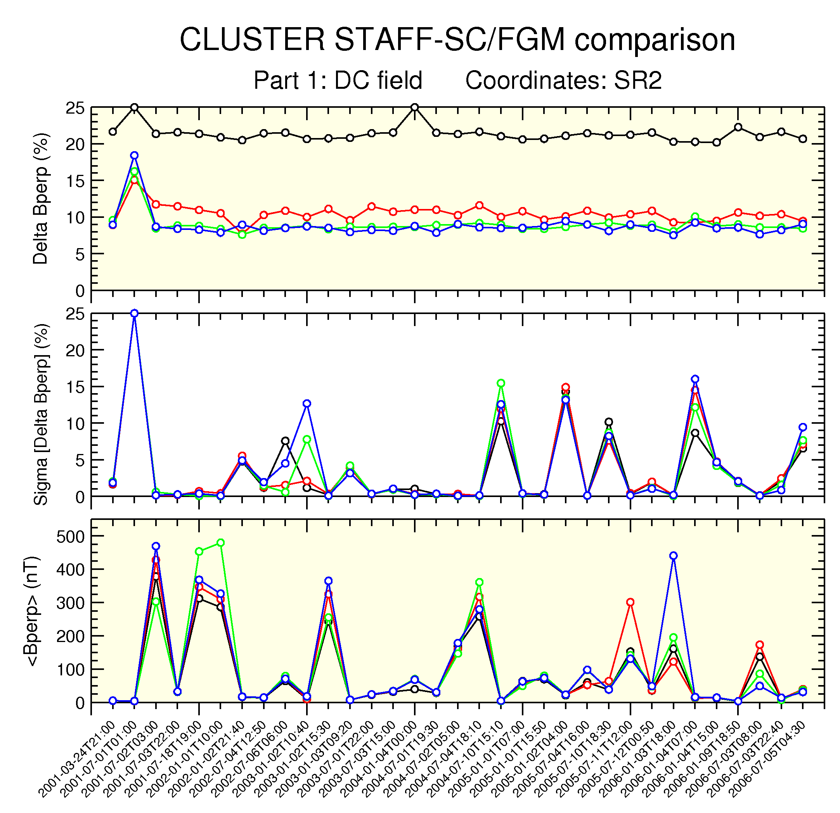
4. STAFF-FGM Cross-Calibration:
b. Statistical comparison

Slide 17
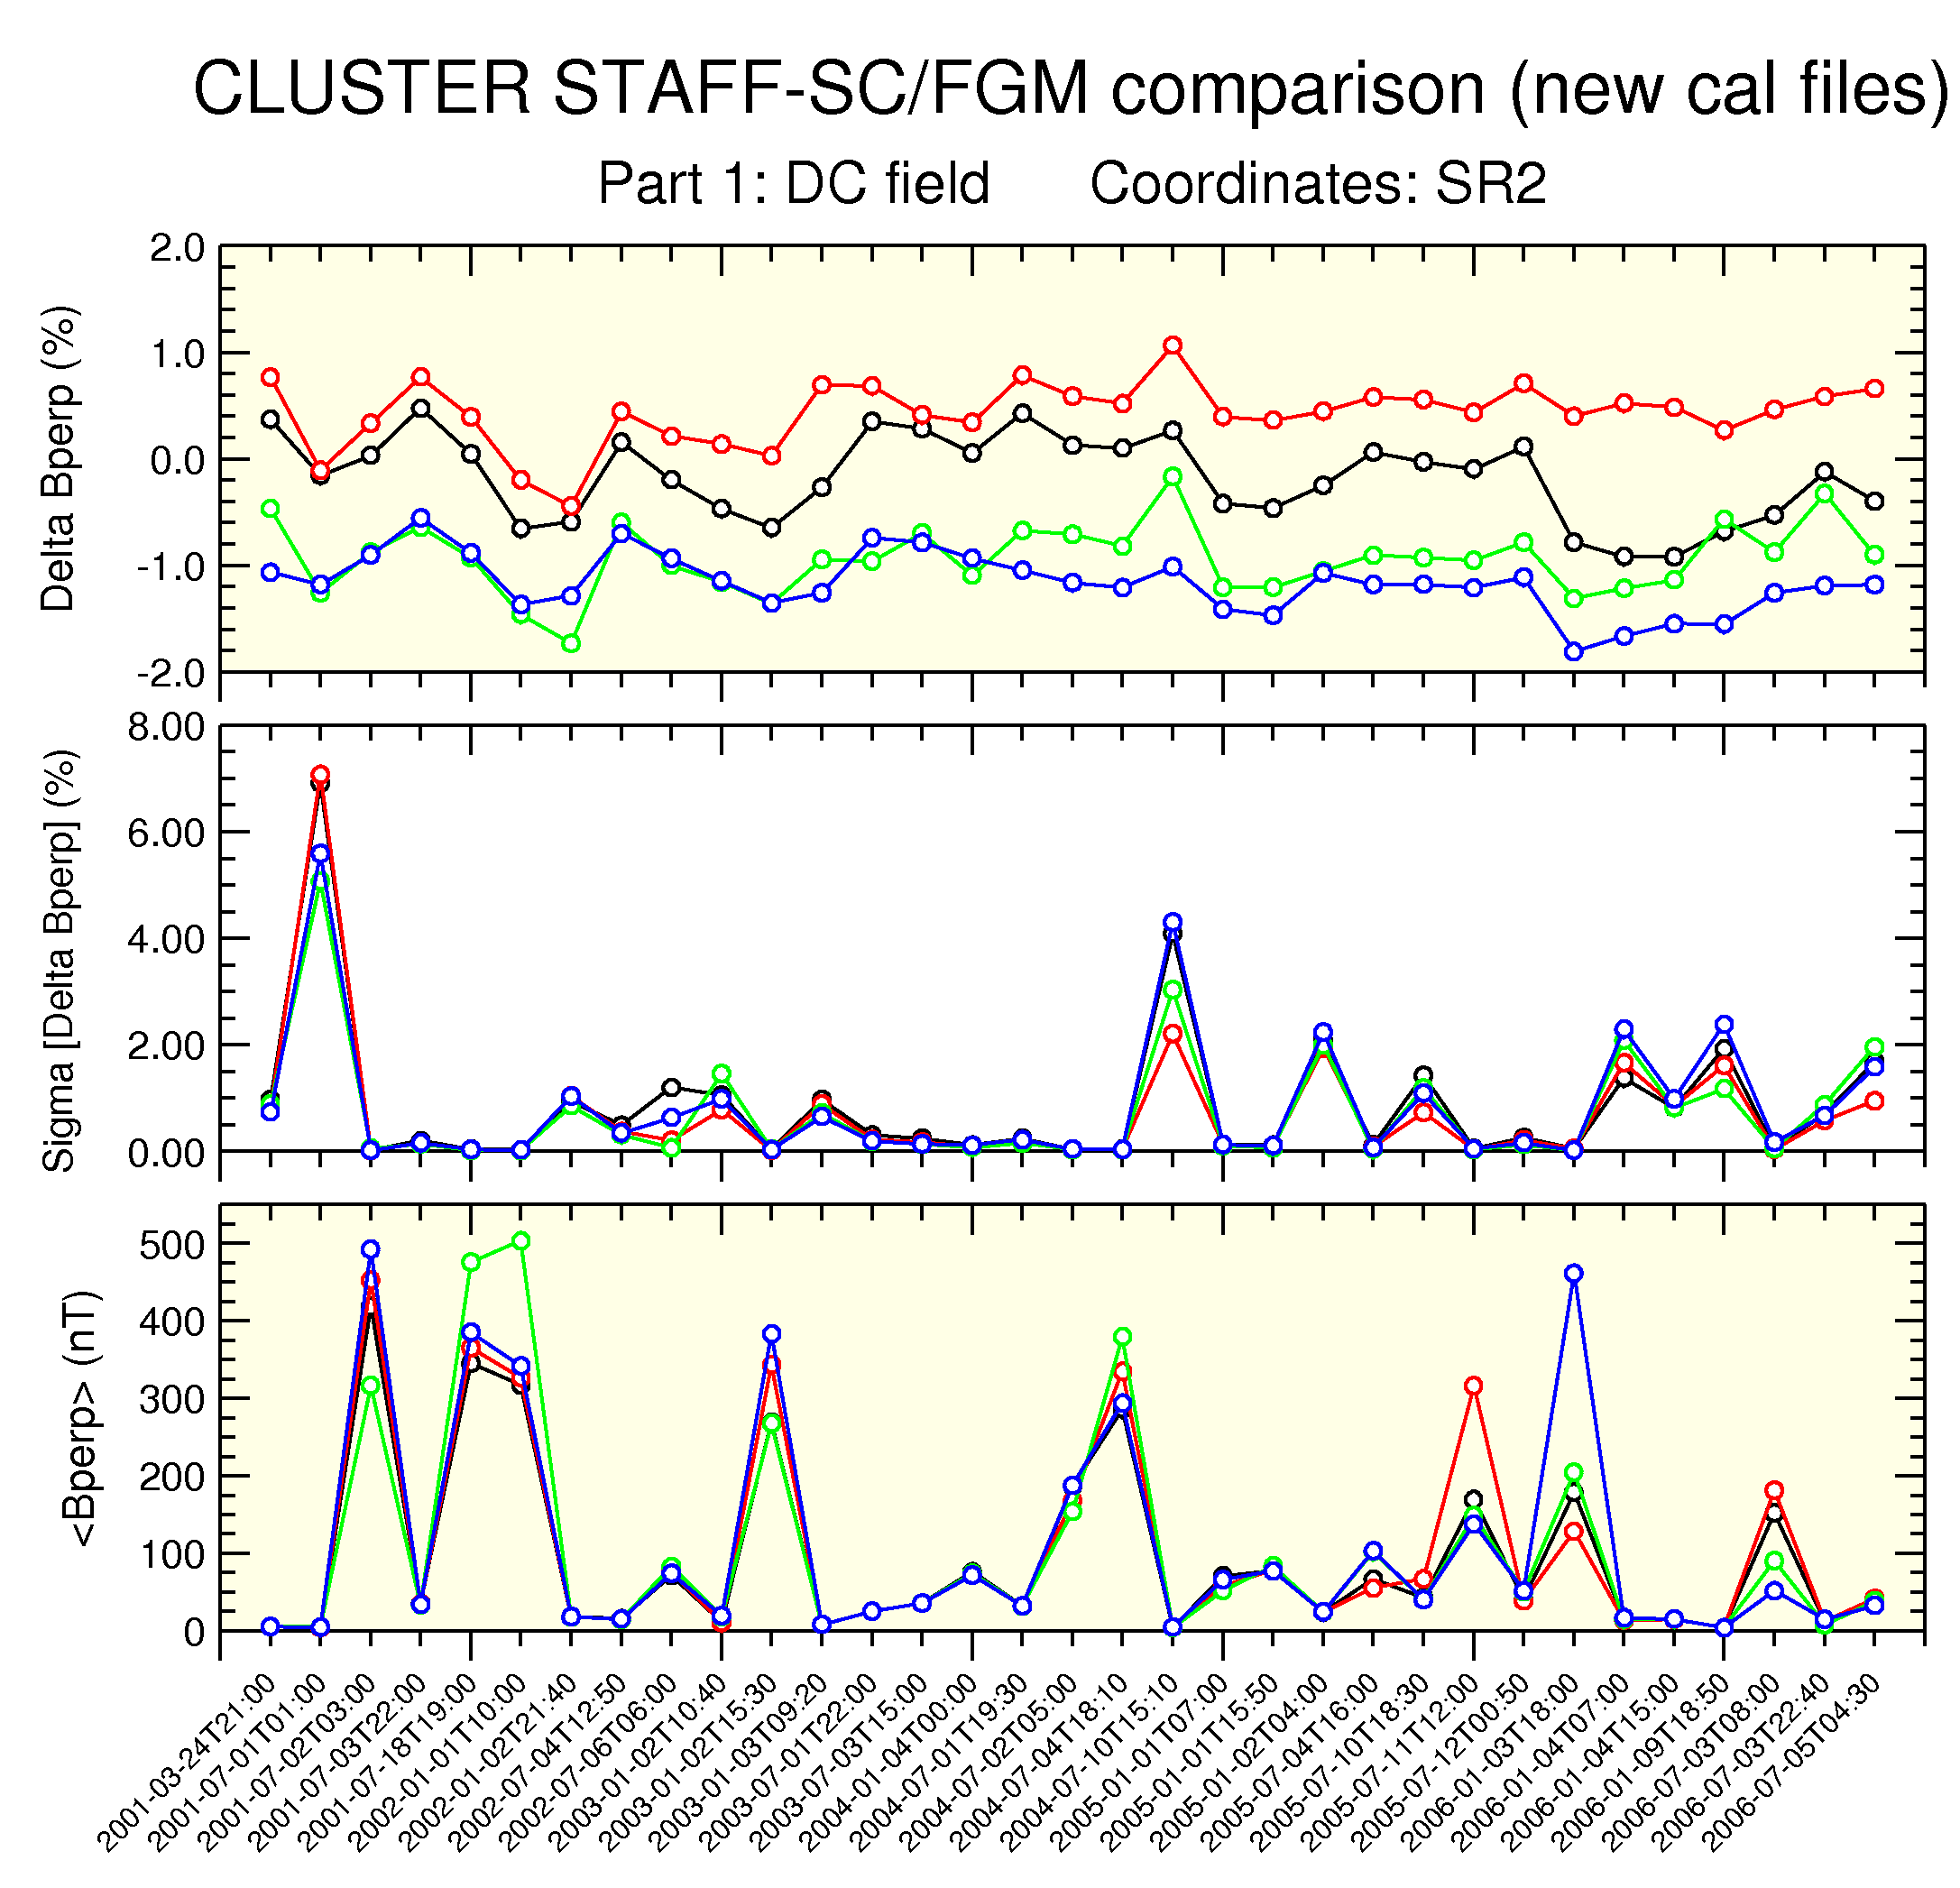
4. STAFF-FGM Cross-Calibration:
b. Statistical comparison

Slide 18
5.Conclusions
Data delivery:
  SA OK.
  SC a little late, due to the validation process of the new calibration method, that include a 6 years comparison of FGM and STAFF data.
Cross calibration SC / FGM
  Very good new results due to
    New calibration tables
    New calibration method.
S/C # 2, 3 and 4 : 10% → 1%
S/C # 1 : 20% → 1%
  Still pending:
    spin residue at 2 fs.
    ∆φ ≃ 3° to be confirmed.

